Slide 1
Route optimization algorithm for ridesharing
María Sofía Uribe
Isabel Cristina Graciano
Medellín, 2019/05/16

Slide 2
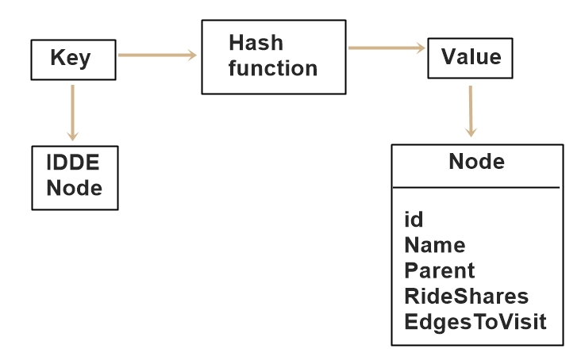
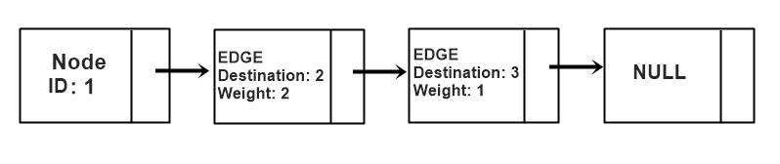
Data Structures
Figure 1: A hash function which has a key (Id node) and a value (Node).
Figure 2: Simply linked list of the edges of a node. Edge is a class that contains Destination and Weight

Slide 3
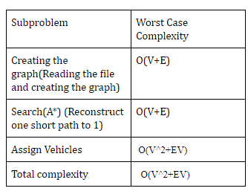
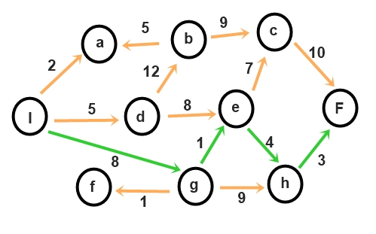
Algorithm and Complexity
Figure 2: Assembly of DNA fragments obtained from a DNA sequencer.
Table 1: Time complexity of every method in the program and the total complexity of the algorithm.

Slide 4
Algorithm design criteria
After the analysis of some possible solutions, we concluded that is is easier to use HashTables because it allows us to reduce the required time for searching and insertion and LinkedLists so we can have in each value of the HashTable a node.
To find the shortest path among the nodes in the Graph we used A* algorithm because it has a low complexity in the worst case performance so it will not increase the performance of our algorithm and it can find a path between multiple points.

Slide 5
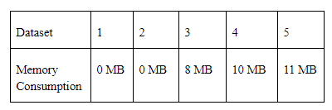
Time and Memory Consumption
Figure 3: Memory consumption of the ridesharing algorithm based on five given dataset.

Slide 6
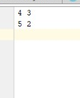
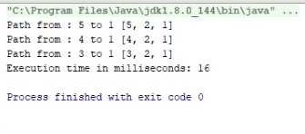
Software prototype
Figure 4: Execution of the program.
Figure 5: Result of the program

